Slide 1
6AMB Telegram Bot Workshop

Slide 2
Recap Syllabus
Installing Python and using the terminal
Recap of Intro Workshop
Python variables
Python data types
Logical operators
Strings
Booleans
Lists, Sets, Tuples and Dictionaries
Conditional Statements and Loops
Functions

Slide 3
Using Replit
Although the original plan was to use the built in terminal, it is probably more reasonable to use an online compiler for this course
We will be using Replit (https://replit.com/)
The next few slides are still valuable resources to teach you how to download Python if you so choose (skip to slide 9 for content)

Slide 4
How to Download Python
Unlike the first course, today we will have to download python!
The steps are pretty simple but need to be followed precisely for your given operating system

Slide 5
Downloading Python contd
Visit https://www.python.org/downloads/
Download and install Python 3.9.7 for your given operating system
Windows:
Click the option that asks if you want to add Python to path
Mac:
If you are using a Mac, open up Terminal using finder
type in 'sudo nano /etc/paths’
type in your password
go to the bottom of the file using arrow keys
Add the line '/usr/local/bin/python3'
Press control-x and then 'Y' to exit

Slide 6
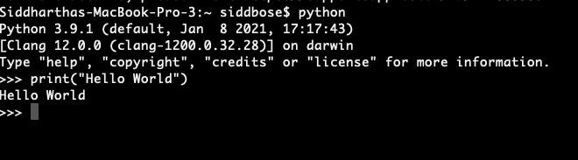
Hello World
So, to start we will create a “hello world” program in python
Type in “python” into your CLI
Then type in print(“hello world”)

Slide 7
Downloading Visual Studio Code
In order to write our code, today we will be using program called Visual Studio Code (created by Microsoft)
Visit this link to download the appropriate version for your computer
https://code.visualstudio.com/download
Once downloaded let’s install the python extension using the extensions tab on the left hand side
Lastly, let’s open up a terminal and get started

Slide 8
Understanding CLI
Command Line Interface is essentially a window into the heart of your computer. It allows you to manipulate files and directories through simple text.
Some useful commands include:
cd – change directory: you can move into and out of folders like this
cd Documents: this will move you into your documents folder
mkdir – make directory: you can create folders like this
touch [filename] – you can create files like this
python3 file.py - you can run python files like this

Slide 9
Python Introduction Recap
Now that we have downloaded Python let’s do a recap of the last workshop
This recap should take the majority of the morning session, followed by the bot creation in the afternoon
Let’s start with variables
How to use them
How to name them
How to output them

Slide 10

Variables Recap
Variables are the building block for python
You can use them to store and manipulate data
Since Python is “dynamically typed” we can initialize variables without explicitly telling the program what type they are
As show above, x is an integer, y is a string and z is a float

Slide 11
Python Data types
We have seen a few data types but let’s go through all of the important ones here
Text: string (“hi”)
Numeric: int (5), or float (5.0)
Sequences:
List: [1,2,3]
Tuple: (1,2,3)
Mapping:
Dictionary: {“name”: “Sidd Bose”, “rank”: ”CPL”}
Boolean:
True, False (capitalization matters here!)

Slide 12

Casting Variables
Although variables are dynamically typed in Python, we also have the concept of casting
Using casting we can ”tell” the program what type we want a variable to be
As shown above, 5 can be represented in different ways if we cast it

Slide 13
Naming Variables
Naming variables is relatively simple in python but we must follow a few rules:
The variable must start with a letter or underscore
The variable can only contain alphanumeric characters and underscores (A-z, 0-9, and _ )
Capital letters and lowercase letters refer to different variables

Slide 14
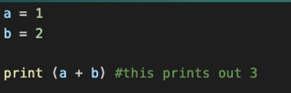

Inputting and Outputting Variables
Outputting variables is simple using the print() command
Similarly, inputting variables uses the input(prompt) command as follows, where prompt is the user prompt for input

Slide 15
Logical, Arithmetic and Comparison Operator Recap
Having variables is one part of the battle, but often we want to compare, contrast or compute!
In order to do so we can leverage different operators
Logical: Checking if two or more statements is true
Arithmetic: Using variables to do math
Comparison: Comparing the magnitude or equality of variables

Slide 16
Logical Operators
These operators show how python leverages English
and, for example x < 5 and x < 10
Returns True if both statements are True, False otherwise
or, for example x < 5 or x < 4
Returns True if either statement is True, False if both are False
not, for example not(x < 5)
Returns True if the inside statement is False, True otherwise

Slide 17
Arithmetic Operators
Most of these should be very intuitive for all of us
These operators work between two numeric values
Addition (+), for example x+y
Subtraction (-), for example x-y
Multiplication (*), for example x*y
Division (/), for example x/y
Modulus (%), for example x % y (where x % y gives the remainder)
Exponentiation (**) for example x**y (which is x^{y})

Slide 18
Comparison Operators
These are also intuitive, but the syntax is key
Equal (==), for example 5 == 5 is True
Not equal (!=), for example 5 != 5 is False
Greater than (>), for example 8 > 7 is True
Greater than or equal to (>=), for example 6 >= 7 is False
Lesser than (<), for example 7 < 8 is True
Lesser than or equal to (<=), for example 7 <= 6 is False
In each case, the result of this operator will tell you if the comparison is True or False
For example, x = 2, y = 3, then x == y returns False and y >= x returns True

Slide 19
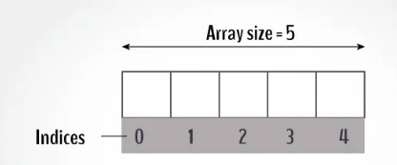
Strings Recap
As we know, a string is a word or character encapsulated in quotations: “var” like this
Since a string is an array/list of characters, we can access elements by indexing as shown below
For example, if x = “hello”, then x[0] is “h”

Slide 20
String Methods
The most important string methods are as follows (using x = “abc” and y = “defg” as examples):
len(x)-> will return the length of x, or 3
x[1:3] -> will return “bc” as a sliced string (format is [first index: last index +1])
x+y-> will return “abcdefg”
For more string methods, visit:
https://www.w3schools.com/python/python_strings_methods.asp

Slide 21
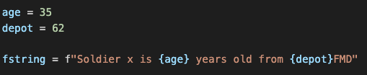
F Strings
In Python F Strings allow us to insert variables into a string
The syntax is as follows: f”string {var} string”
This allows us to concatenate a string more naturally

Slide 22

Booleans and how to use them
If you recall, Booleans are simple True and False values
When we use logical and comparison operators, Booleans are the result
You can evaluate statements and have them print out as True or False

Slide 23
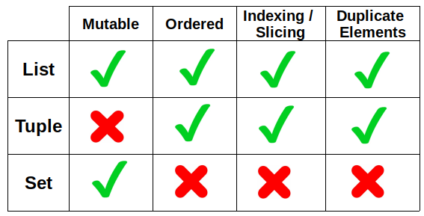
Lists, Sets and Tuples (Lists are most important)
Lists, sets and tuples are all ways to hold multiples pieces of data at the same time
The table below explains the difference between the 3 data types:
Mutable = changeable
Ordered = objects stay in a certain order
Indexing = you can access a value like in a string
Duplicates = you can have multiple of the same value
Examples:
List: [1,1,2,3,4], we can add and remove values
Set: {1,2,3,4} we can add and remove values but we can’t access via indexing
Tuple: (1,2,3,4,4), we cannot add or remove values but we can index

Slide 24
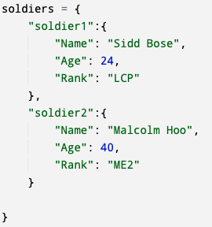
Dictionaries Recap
Perhaps the most powerful data type mentioned thus far, dictionaries use ‘keys’ to index into them
For example, a dictionary could be instantiated as follows:
This is an example of a nested dictionary
Essentially the dictionary ”soldiers” contains:
Dictionaries for each soldier and those contain:
Name, age, rank
Soldier1’s rank can be obtained as such
soldiers[“soldier1”][“Rank”]

Slide 25
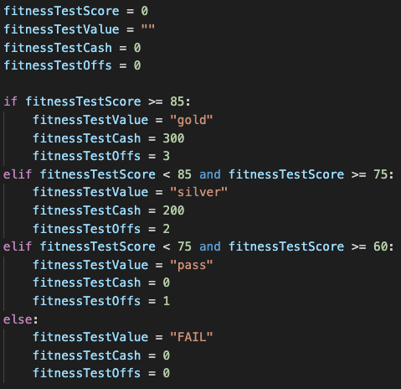
Conditional Statements Recap
If you recall, conditional statements use logical operators to check certain conditions and execute different blocks of code
The format is:
If, elif …., else
As we see on the right, if a condition is met, a certain block of code is executed
If no conditions are met, only the else block is executed
We need to ensure that indentation is correct in if else blocks otherwise python will not run

Slide 26
Loops: While and For
Looping is the best way to run a certain piece of code repeatedly
In python the two most common forms of loops are while and for loops
For the most part, both can be used interchangeably and are up to the programmer to choose which one suits them or the task best

Slide 27
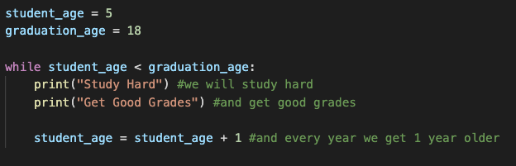
While Loops
Looping is critical in control flow because it allows us to do the same set of tasks repeatedly without having to explicitly write them out
A while loop is much like it sounds
While a certain condition is met do a job
For example, in English we might say:
While you are in school, study hard and get good grades
The following is an example of this sentiment

Slide 28


For Loops
For loops are very similar to while loops but in python they allow you to write code in a more concise manner
For example, if we want to print out the list from the previous section, we would write it as such
You can obviously also use for loops just like while loops where you manually iterate (the range function iterates through values for you):

Slide 29
Functions
The last part of today’s recap is functions
Functions allow for a task, or a block of code to be encapsulated
This code is only run when it is ”called”
Functions can take inputs, usually as ”parameters” and can output either as print statements or as return values as we mentioned earlier

Slide 30
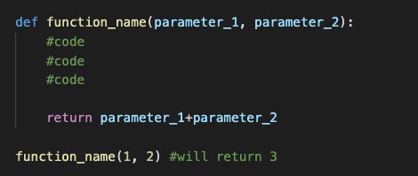
Functions Contd.
In order to declare a function the syntax is as follows:
A function can have zero or more arguments/parameters
This information can then be used or manipulated and then returned
In order to ”call” a function, we simply type the name of the function with the relevant parameters as shown above

Slide 31
Recap Over!
Okay, recap was a lot of information but it will be crucial for the next part of the day
For the second half of the workshop we will first work on first creating a simple bot that we can interact with
Hopefully by the end you will have the tools to use code from our last workshop to build a slightly more useful bot

